Slide 1

Module 1: Introduction to cloud computing

Slide 2
Cloud computing
Cloud computing was created because
the amount of data an organization has to store and manage has grown exponentially over the past few decades.
Companies were beginning to install more and more physical storage space, which became ever more expensive and cumbersome.
Cloud storage & infrastructure removes this burden.

Slide 3
Cloud computing
Cloud platforms provide a variety of services and resources over the internet, allowing users to access and utilize computing power, storage, databases, networking, and other services without the need for on-premises infrastructure.
There are several prominent cloud platforms, each with its unique features and strengths.

Slide 4

Cloud Architectures
Public cloud — data and other info delivered over the internet that can be shared with various people and organizations
Private cloud — data and other info that is only accessible to users within your organization
Hybrid cloud — a combination of the two

Slide 5
What Is a Public Cloud?
Anything said to live in the cloud refers to docs, apps, data, and anything else that does not reside on a physical appliance; your computer, a server, hard drive, etc.
A public cloud does not mean that just anyone can log in, but it is more accessible than other types of clouds.
High scalability and elasticity
Low-cost tier-based pricing

Slide 6
What Is a Public Cloud?
Public cloud services are often free or offered as a subscription-based service.
The computing functionality they provide can range from basic services such as email, apps, and storage to enterprise-level OS platforms or infrastructure environments your team can use for software development and testing.

Slide 7

What Are the Benefits of a Public Cloud?
Strong cyber security — Attracting the most talented engineers in the world takes money
Advanced technology creates more security innovations — More modern technology has led to advanced security services

Slide 8
What Are the Benefits of a Public Cloud?
Stringent penetration testing — Public clouds are put through stringent penetration tests and are held to stiffer standards than any on-premise solutions or private cloud options
Controlled access — The majority of data breaches result from human error

Slide 9
What Are the Benefits of a Public Cloud?
Saves time — When you use a public cloud, you don’t have to worry about managing hosting
Saves you money — The amount of money organizations can save with the public cloud depends on the size of the operation

Slide 10





Benefits of a Public Cloud?
There are no capital investments — You don't need to buy expensive equipment or extra space
Public clouds are maintained and updated by the host — You are not responsible for any additional costs
Pay only for what you use — This eliminates paying for unused resources and you always have the flexibility to scale up or down, giving just the computing capacity you need
Lower energy costs — Without powering internal servers, you save money on energy costs
Free up IT time — IT talent can concentrate on more revenue-generating activities, instead of spending all of their time managing a data center

Slide 11
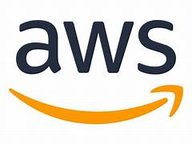
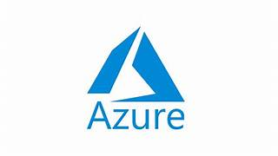
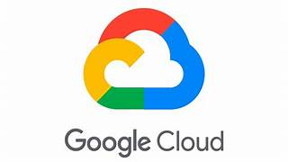
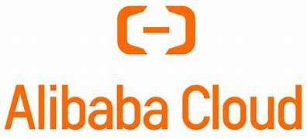
Largest Public Cloud Providers
Amazon Web Services — Amazon Web Services (AWS) is the world’s most comprehensive and broadly adopted cloud.
Microsoft Azure — Microsoft Azure launched many years later than AWS and Google Cloud, but it quickly rose to the top
Google Cloud Platform — Google’s cloud is similar to AWS and Azure
Alibaba Cloud — Alibaba Cloud, also known as Aliyun, is a cloud computing company, a subsidiary of Alibaba Group.

Slide 12
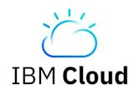
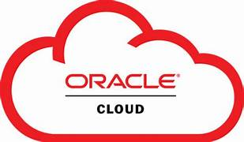
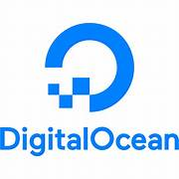
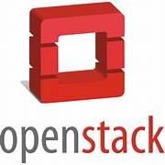
Largest Public Cloud Providers
IBM Cloud —Offers a range of services, including AI and blockchain, with a focus on enterprise solutions.
Oracle Cloud — Emphasizes on database and enterprise applications.
Digital Ocean — Popular among developers and startups for its simplicity and developer-friendly approach
Open Stack— Often used for building private and hybrid clouds

Slide 13
What Is a Private Cloud?
The private cloud is a cloud solution that is dedicated to a single organization.
You do not share the computing resources with anyone else.

Slide 14
What Is a Private Cloud?
The data center resources can be located on your premises or off-site controlled by a third-party vendor.
The computing resources are isolated and delivered to your organization across a secure private network that is not shared with any other customers.

Slide 15
What Is a Private Cloud?
The private cloud is completely customizable to meet the company’s unique business and security needs.

Slide 16
What Is a Private Cloud?
Organizations are granted greater visibility and control into the infrastructure, allowing them to operate sensitive IT workloads that meet all regulations and without compromising security or performance that could previously only be achieved with dedicated on-site data centers.

Slide 17
Private clouds are best suited for:
Highly sensitive data
Government agencies and other strictly regulated industries
Businesses that need complete control and security over IT workloads and the underlying infrastructure

Slide 18
Private clouds are best suited for:
Organizations that can afford to invest in high-performance technologies
Large enterprises that need the power of an advanced data center able to operate efficiently and cost-effectively

Slide 19
What Are the Benefits of a Private Cloud?
Exclusive, dedicated environments — The private cloud is for your use only
Somewhat scalable — The environment can be scaled as needed without tradeoffs

Slide 20
What Are the Benefits of a Private Cloud?
Customizable security — The private cloud complies with stringent regulations, keeping data safe and secure through protocol runs, configurations, and measures based on the company’s unique workload requirements

Slide 21
What Are the Benefits of a Private Cloud?
Highly efficient — The performance of a private cloud is reliable and efficient
Flexible — The private cloud is able to transform its infrastructure according to the growing and changing needs of the organization

Slide 22
Drawbacks of a Private Cloud
Price — The cost of a private cloud solution is quite expensive and comes with a relatively high total cost of ownership compared to public cloud alternatives, especially in the short term

Slide 23
Drawbacks of a Private Cloud
Not very mobile-friendly — Mobile users may have limited access to the private cloud because of the high security measures

Slide 24
Drawbacks of a Private Cloud
Limited scalability — The infrastructure may not offer enough scalability solutions to meet all demands, especially when the cloud data center is restricted to on-site computing resources

Slide 25

Examples of Private Cloud

Slide 26



Financial Sector – JPMorgan Chase
Enhanced Security: Protects sensitive financial data and transactions
Compliance: Meets regulatory requirements such as GDPR and PCI DSS
Scalability: Supports the bank's massive operations while ensuring reliability

Slide 27


Data Security: Ensures patient confidentiality and compliance with HIPAA regulations
Healthcare Industry - Mayo Clinic
Accessibility: Enables secure access to patient records for healthcare professionals
Efficiency: Streamlines administrative and clinical processes

Slide 28

Government Sector - NASA
Data Sovereignty: Maintains control over classified and sensitive information
Performance: Supports high-performance computing for space exploration missions
Collaboration: Facilitates collaboration among researchers and scientists

Slide 29

Manufacturing Industry - Toyota
Toyota, a leading automotive manufacturer, employs a private cloud for its manufacturing processes
Benefits
Intellectual Property Protection: Safeguards proprietary designs and trade secrets
Efficiency: Optimizes production processes and supply chain management
Flexibility: Adapts to changing market demands and production requirements
Case Study Highlights: Improvements in production efficiency, quality control, and innovation

Slide 30

Research Institutions - CERN
CERN, the European Organization for Nuclear Research, utilizes a private cloud for scientific data processing
Benefits
Data Analysis: Handles massive volumes of data generated from particle physics experiments
Collaboration: Facilitates collaboration among scientists from around the world
Innovation: Supports groundbreaking discoveries and advancements in particle physics
Case Study Highlights: Notable discoveries and contributions enabled by private cloud infrastructure

Slide 31
Difference Between a Public and Private Cloud?
A public cloud solution is all about delivering IT services directly to the client over the internet
This cloud-based service is either free, based on premiums, or by subscription according to the volume of computing resources the customer uses

Slide 32
Difference Between a Public and Private Cloud?
Public cloud vendors will manage, maintain, and develop the scope of computing resources shared between various customers
One main differentiating aspect of public cloud solutions is their high scalability and elasticity.

Slide 33
Difference Between a Public and Private Cloud?
A private cloud puts the main focus on virtualization and thereby is able to separate the IT services and resources from the physical device.
Applications are available virtually on the cloud, as they do not run locally on servers or end devices.

Slide 34
Difference Between a Public and Private Cloud?
An ideal solution for companies that deal with strict data processing and security requirements.
It allocates services according to the needs of the client, making it a more flexible option.

Slide 35
Difference Between a Public and Private Cloud?
For tighter security, a firewall is installed to protect the private cloud from any unauthorized access.
Only users with security clearance are authorized to access the data on private cloud applications either by use of a secure Virtual Private Network (VPN) or over the client’s intranet.

Slide 36
Difference Between a Public and Private Cloud?
Users are granted the authentication rights needed to access the services.

Slide 37
What Is a Hybrid Cloud?
A hybrid cloud is a computing environment that combines an on-site data center, sometimes referred to as a private cloud with the power of a public cloud
This allows the two systems to share data and applications between them as needed

Slide 38
What Is a Hybrid Cloud?
A hybrid cloud is defined as a mixed computing, storage, and services environment that is made up of a public cloud solution, private cloud services, and an on-premises infrastructure
Examples of this include Amazon Web Services (AWS) and Microsoft Azure.

Slide 39
What Is a Hybrid Cloud?
Using this combination gives you great flexibility and control and allows you to make the most of your infrastructure dollars.

Slide 40
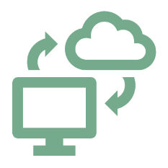


Benefits of a Hybrid Cloud?
Although cloud services are able to save you a lot of money, their main value is in supporting an ever-changing digital business structure
Every technology management team has to focus on two main agendas: the IT side of the business and the business transformation needs
It is also a cost-effective way of getting the resources you need without spending the time or money of purchasing, installing, and maintaining new servers that you may only need occasionally

Slide 41

Security Concerns of a Hybrid Solution
Hybrid cloud platforms use many of the same security measures as on-premises infrastructures, including security information and event management.
Organizations that use hybrid systems find the security to be better than their on-site data center because of the automatic updates, automated data redundancy, disaster recovery, high availability, and strict cyber security features.

Slide 42
What is Multi-Cloud?
A multi-cloud architecture uses two or more cloud service providers from a number of different computing vendors.

Slide 43
What is Multi-Cloud?
The main purpose of a multi-cloud environment is to reduce risks.
Cloud platforms provide a variety of services and resources over the internet, allowing users to access and utilize computing power, storage, databases, networking, and other services without the need for on-premises infrastructure.

